Slide 1

Most Trending Youtube Video Pattern

Slide 2



TEAM MEMBERS
Muhammad Syahmi bin Khairol Anuar
198567
013-6993969
Muhammad Ikhwan bin Roslan
197958
019-4522029
Meor Amirul Amri bin Abdullah
196968
011-18788133

Slide 3
STREAMLIT DEMO

Slide 4
PROBLEM UNDERSTANDING & OVERVIEW
Notes:
Explain overview project

Slide 5
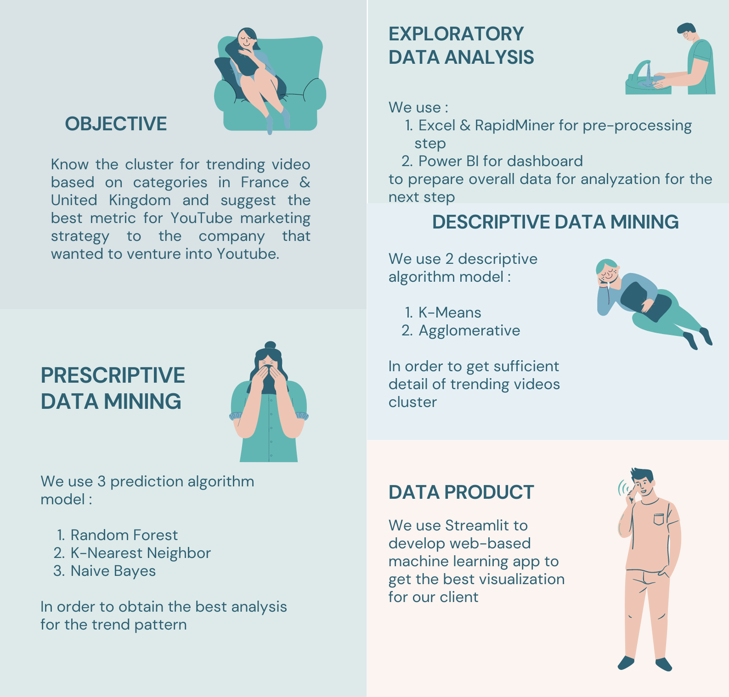

Slide 6
DATA DESCRIPTION
Notes:
Explain dataset & problem

Slide 7
This dataset includes several months (and counting) of data on daily trending YouTube videos. Data is included for UK and FR regions with up to 200 listed trending videos per day.
Origin | France & United Kingdom
Total Columns | 79640
Total Attributes | 17

Slide 8
STAKEHOLDER
Notes:
Explain dataset & problem

Slide 9
The specified company that wanted to venture into Youtube marketing.
Field of company | Entertainment, Music production, Travel
Area of coverage | France & United Kingdom
Total population | 133.71 Million

Slide 10
DATA PRE-PROCESSING

Slide 11
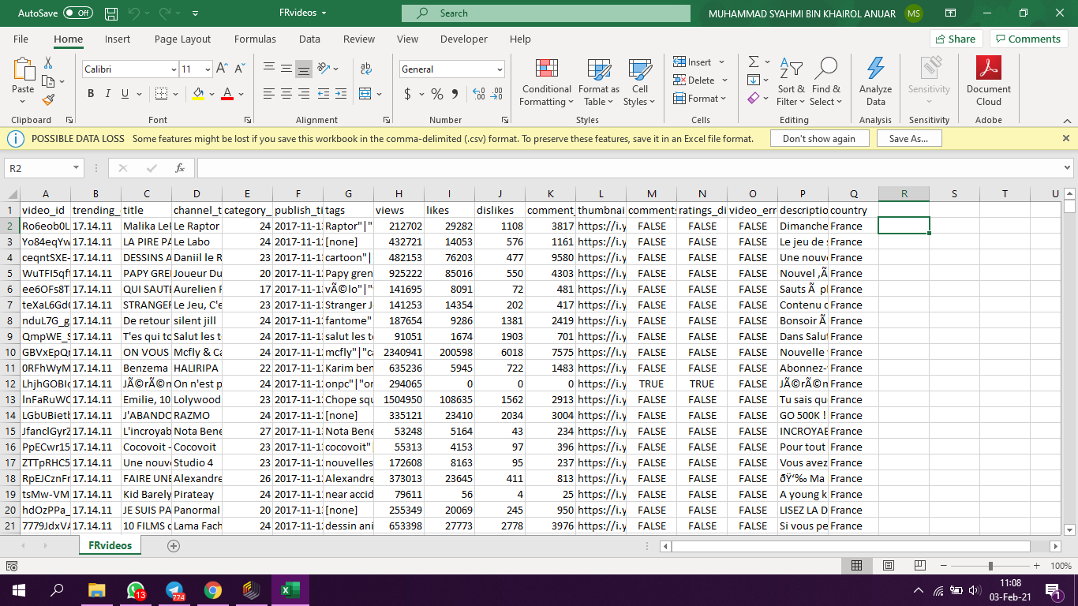
Data Cleaning thru Excel
Notes:
Excel = Produce YTVideos (79640 columns)
-Csv to xls (to prevent data loss)
-Combine data (Fr & GB)
-Add column country

Slide 12
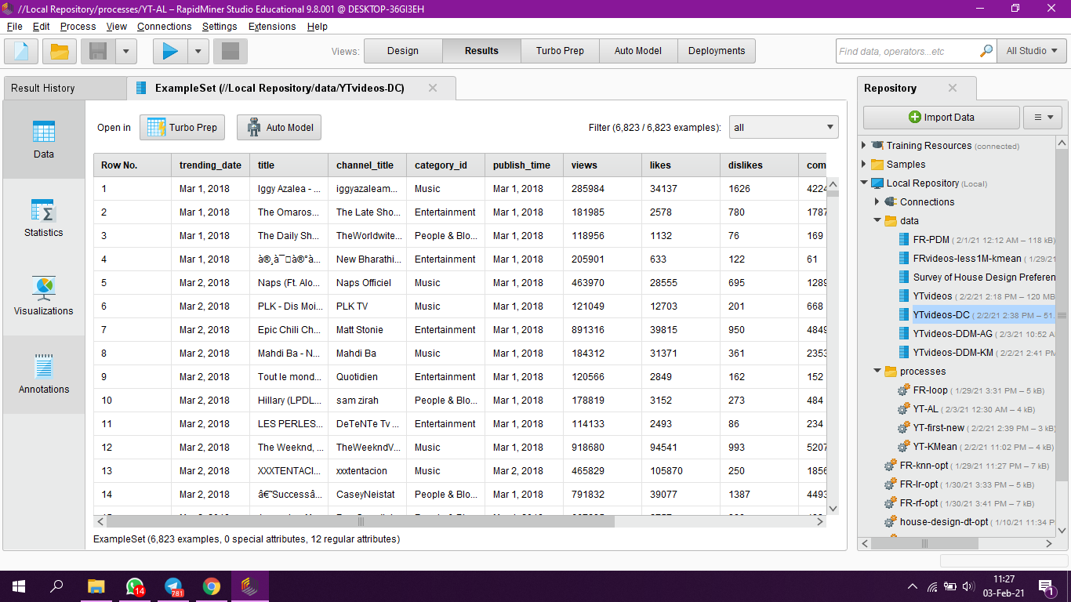
Data Cleaning thru RapidMiner
Notes:
RM =Produce YTVideos_DC
-Transform Data Type of publish_time, trending_date

Slide 13
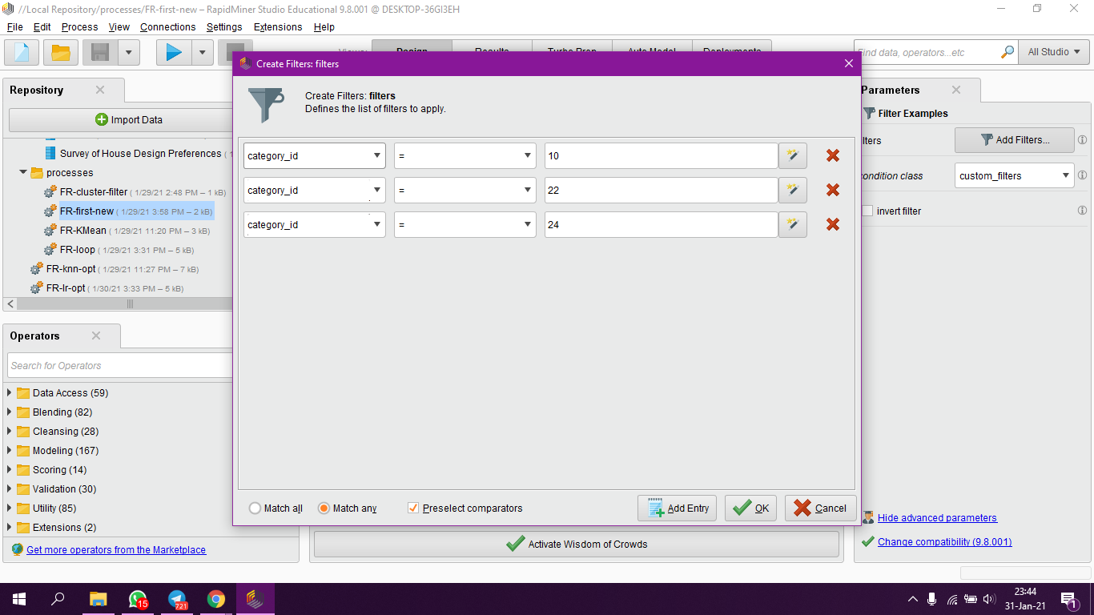
Data Cleaning thru RapidMiner
Notes:
-Filter example (Match any - Category id = 10,22,24)

Slide 14
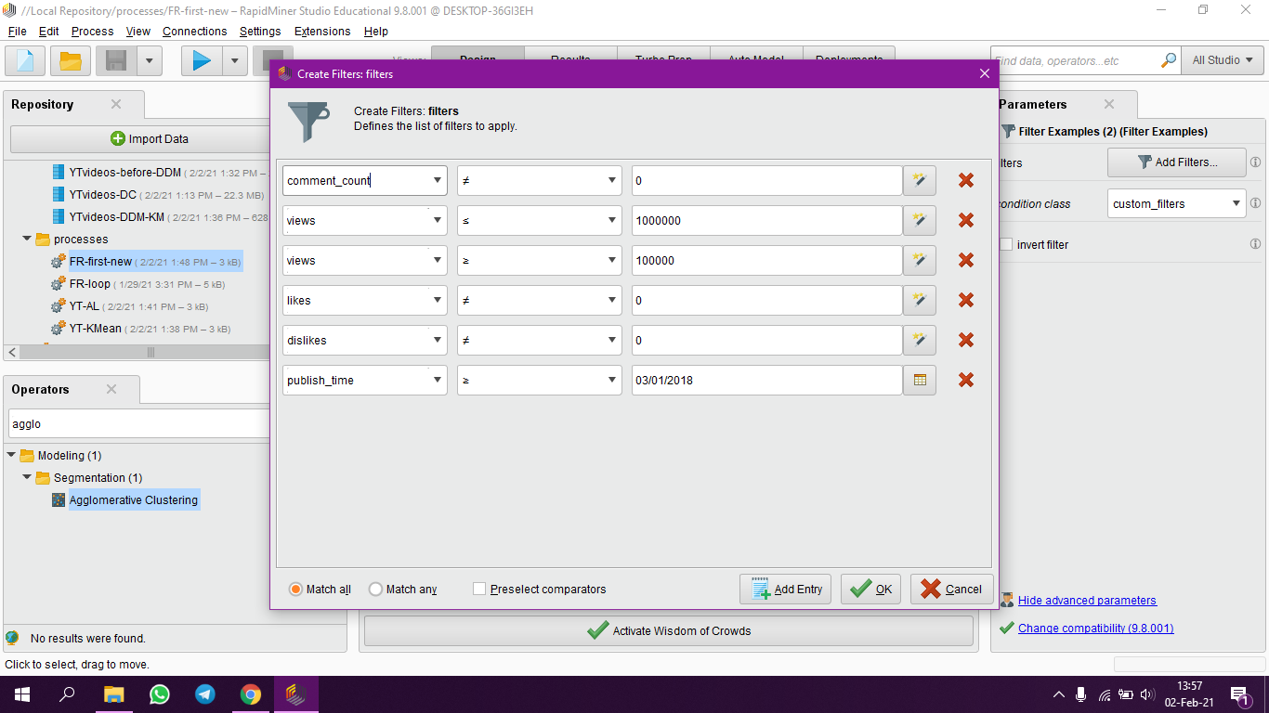
Data Cleaning thru RapidMiner
Notes:
Filter example (Match all)

Slide 15
Data Cleaning thru RapidMiner
Notes:
RM =Produce YTVideos_DC
-Transform Data Type Category_id (24 to Entertainment, 10 to Music, 22 to People & Blogs)
-Remove column video_id, tags, comments_disabled, rating_disabled, video_error_or_removed (12 attributes left)

Slide 16

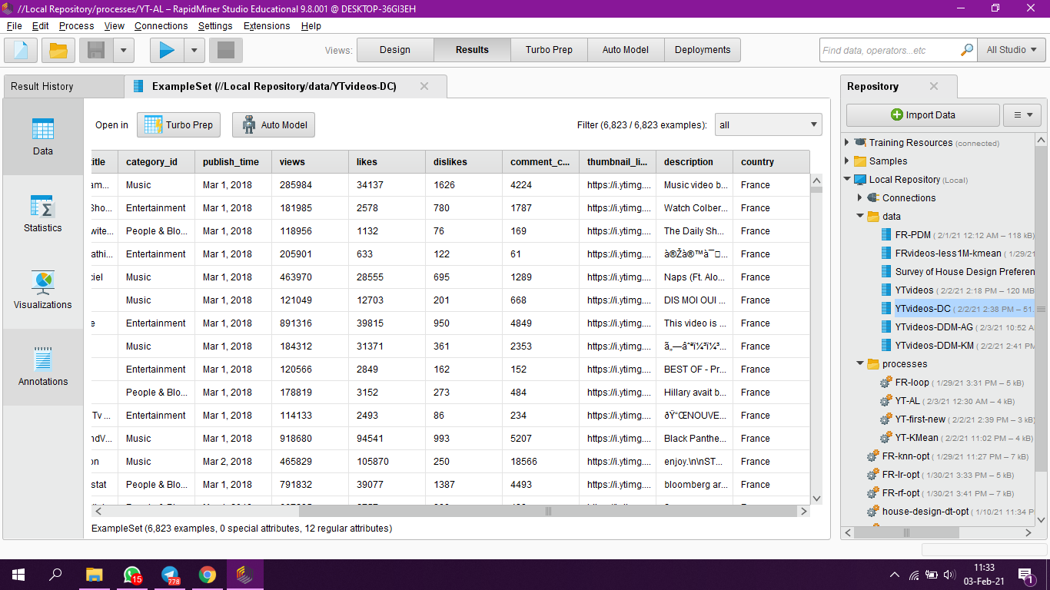
Data Cleaning thru RapidMiner
Notes:
RM =Produce YTVideos_DC
Remaining attributes

Slide 17
EXPLORATORY DATA ANALYSIS
Notes:
EDA

Slide 18
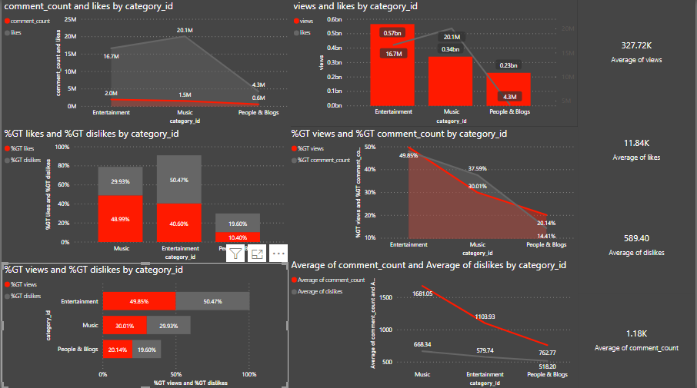
PowerBI Dashboard
Notes:
Present from PowerBI

Slide 19
Exploratory Data Analysis
Questions & Answer :
It is true that the category will have higher number of comments if the category have higher number of likes. (FALSE)
It is true that the category will have higher number of views if the category have higher number of likes. (FALSE)
It is true that the category will have higher number of dislikes if the category have higher number of likes. (FALSE)
What is the average number of views, likes, comments and dislikes from dataset ?
Category with high number of views can have high number of comments ? (TRUE)
Category with higher views can have higher number of dislikes ? (TRUE)
In average, category with high number of comment will have high number of dislikes ? (TRUE)
Notes:
QnA

Slide 20
DESCRIPTIVE DATA MINING
RAPID MINER & PYTHON

Slide 21
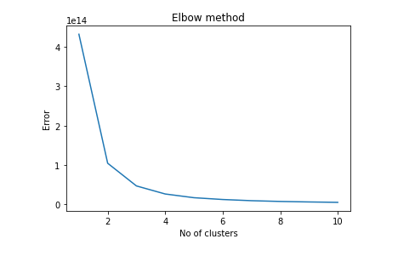
K-MEANS
Using Python
Best k value = 3
Notes:
1- Error
2- Davies Bouldin Values

Slide 22
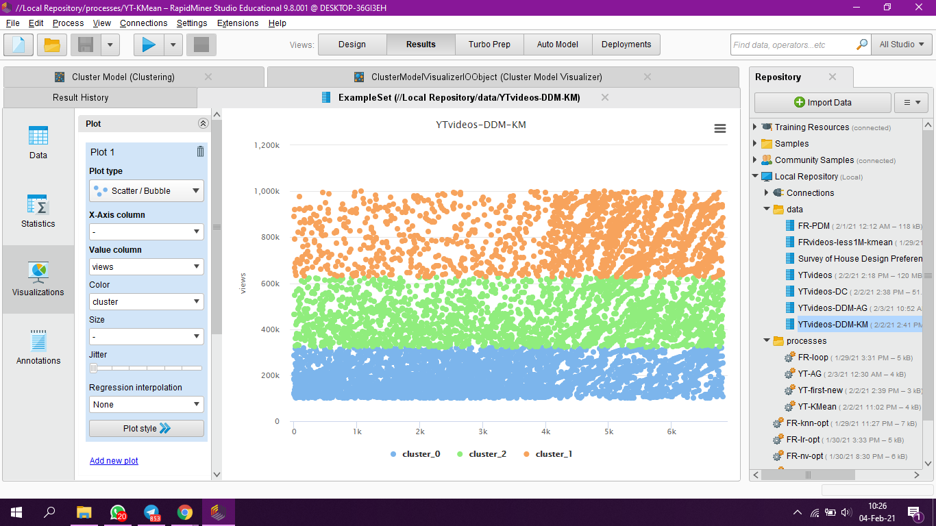
Bubble visualisation (cluster vs views)
Notes:
K Mean Analysis (cluster vs view)

Slide 23
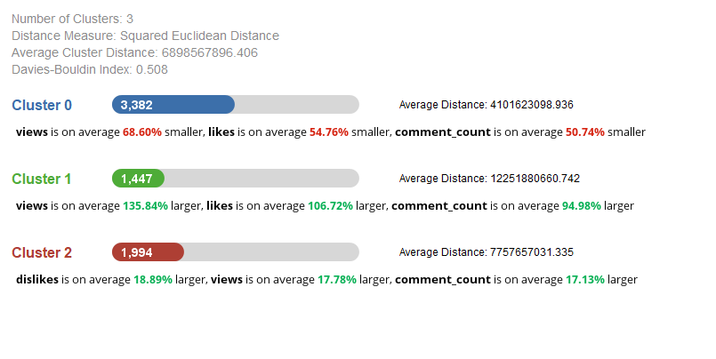
K-Means Analysis
Notes:
Model Visualizer

Slide 24
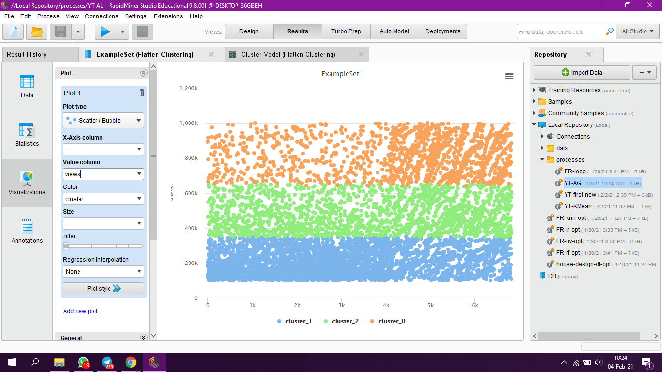
Agglomerative bubble visualisation (cluster vs views)
Notes:
Analysis (cluster vs view)

Slide 25
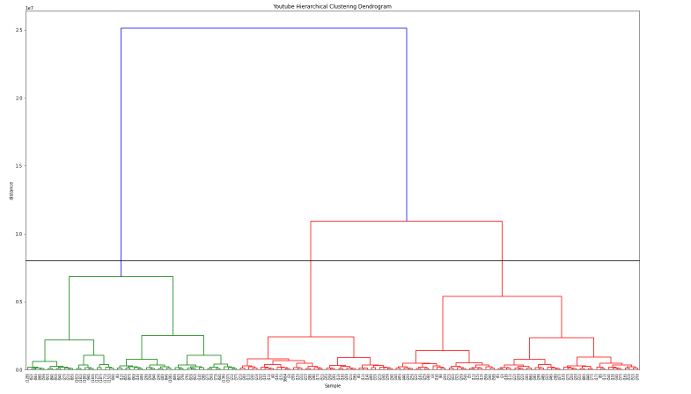
Using Python
Notes:
Agglomerative analysis

Slide 26
PREDICTIVE DATA MINING
RAPIDMINER AND PYTHON

Slide 27
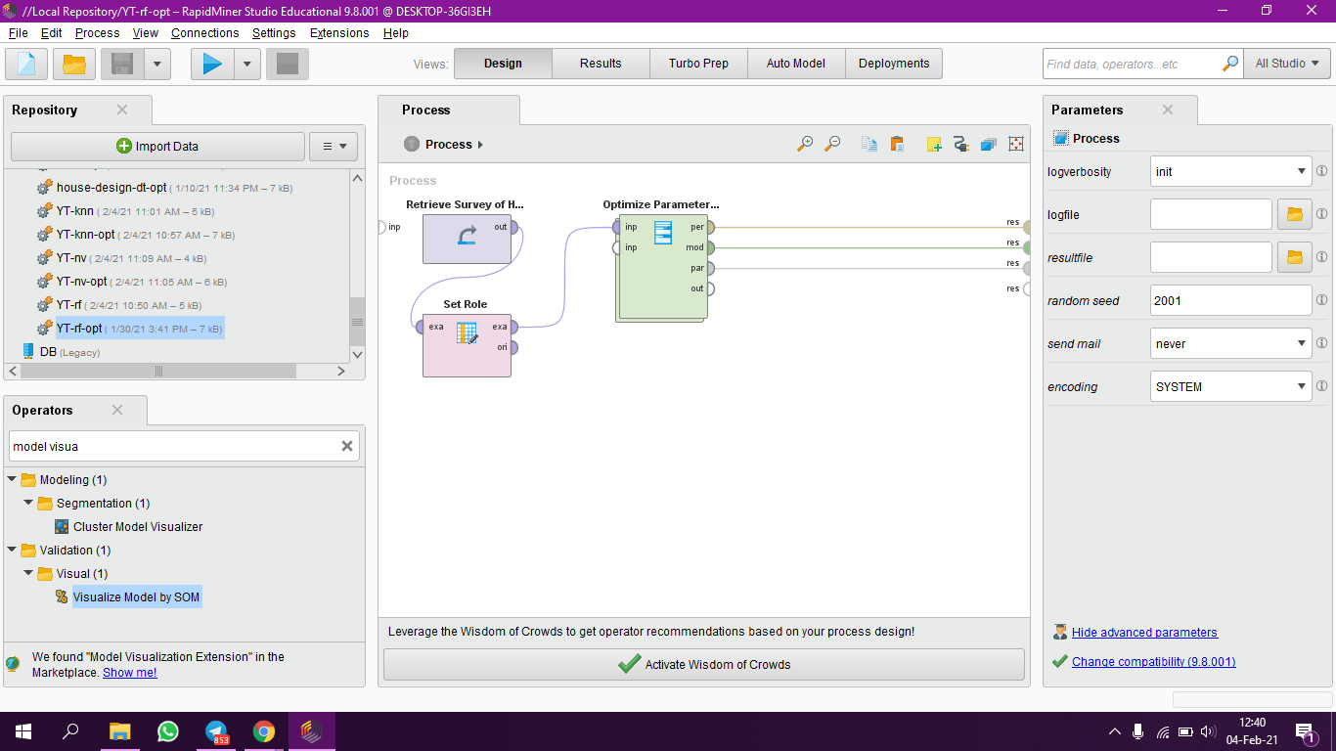
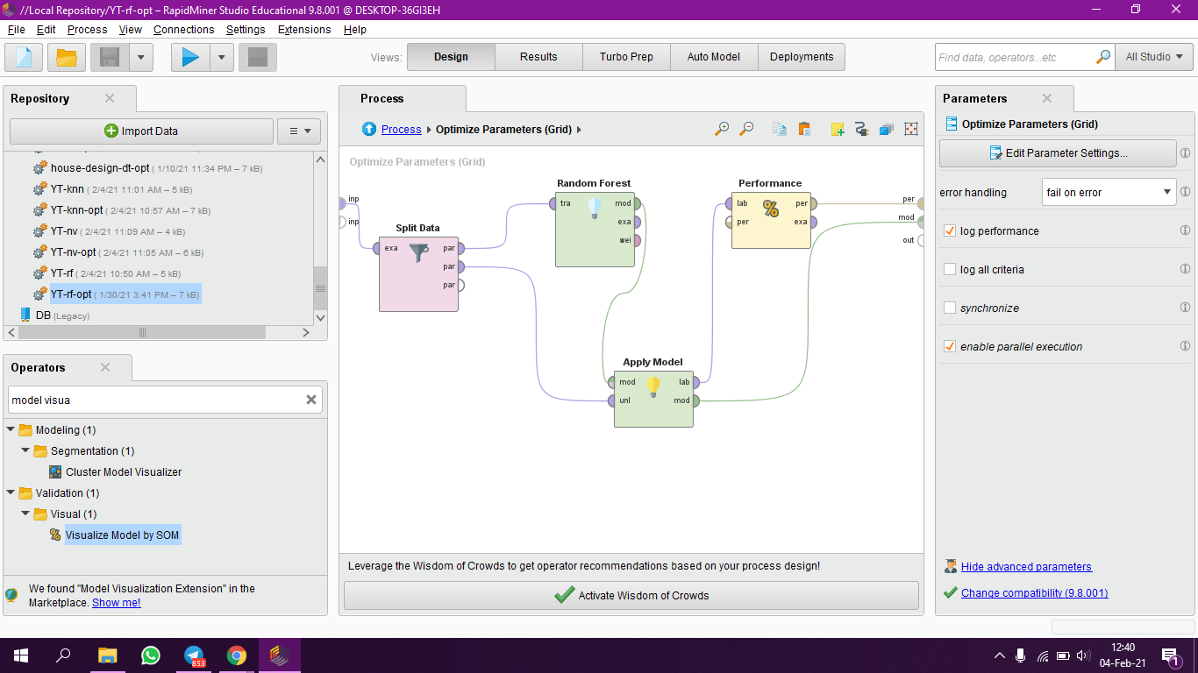
RANDOM FOREST
Notes:
RapidMiner

Slide 28
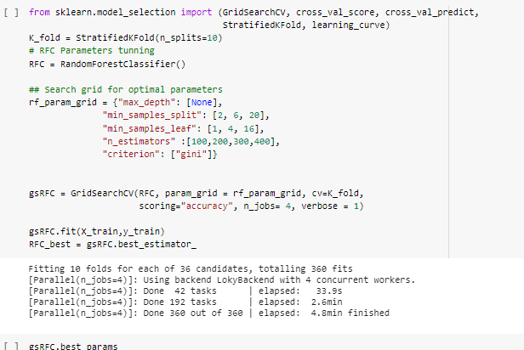
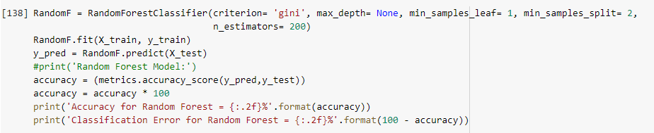
Notes:
Python

Slide 29
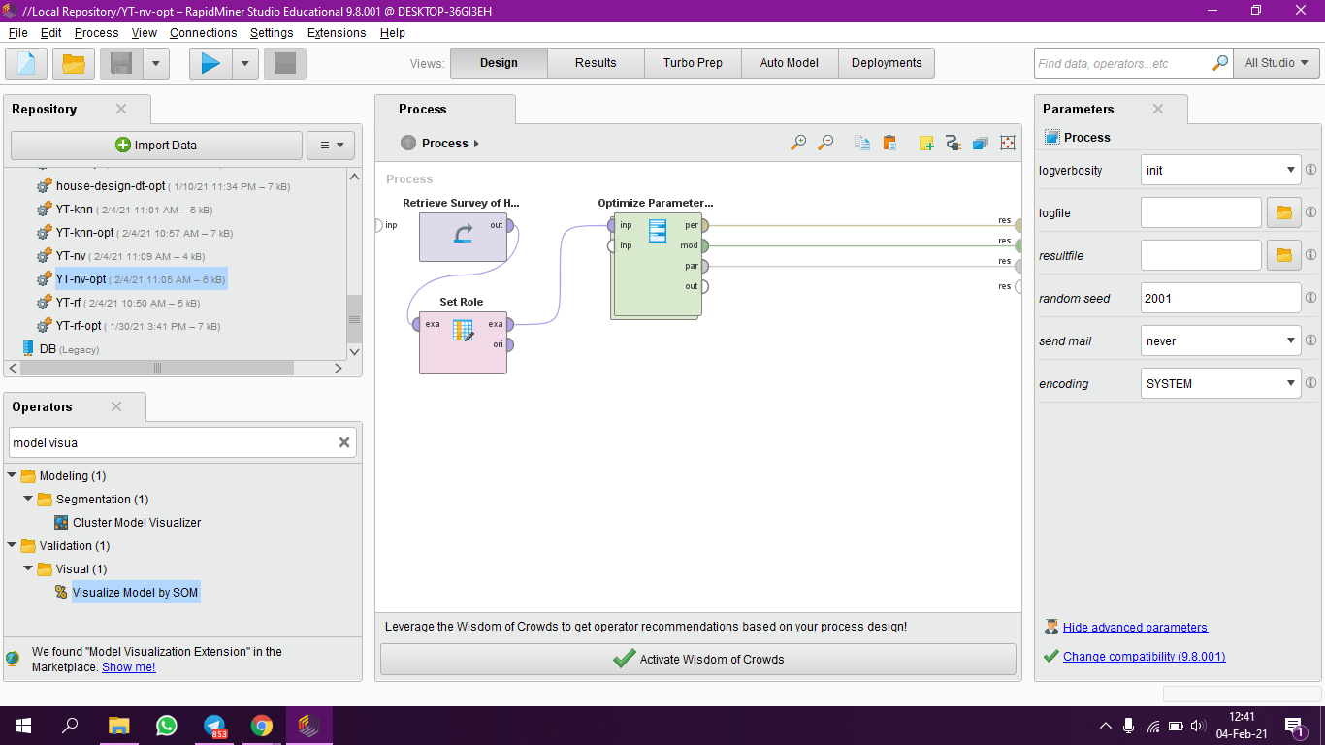
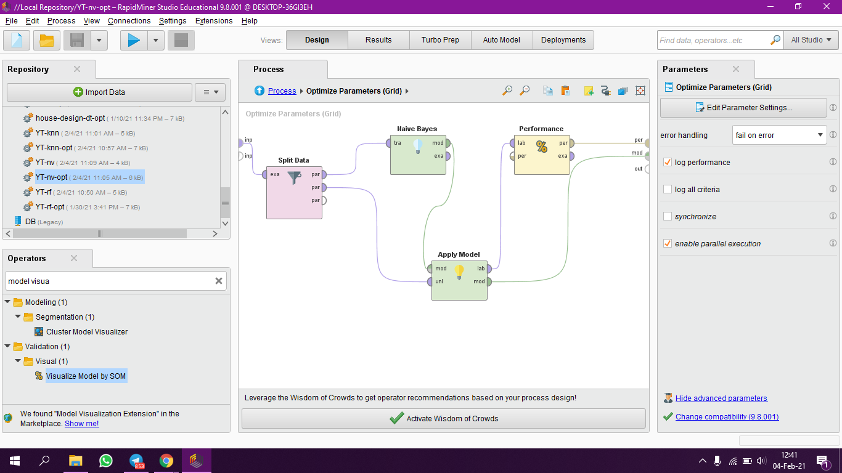
NAIVE BAYES
Notes:
RapidMiner

Slide 30
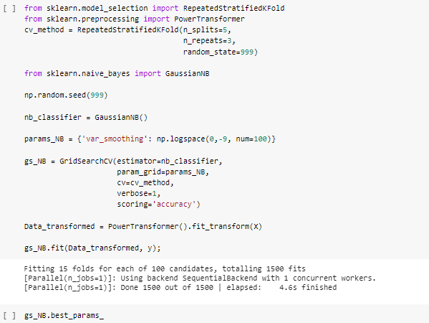
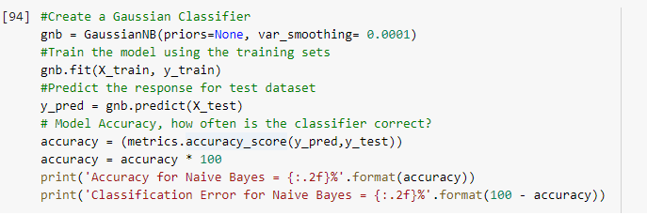
Notes:
Python

Slide 31
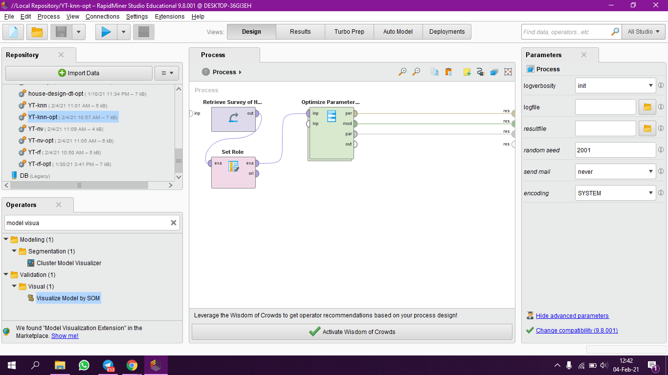
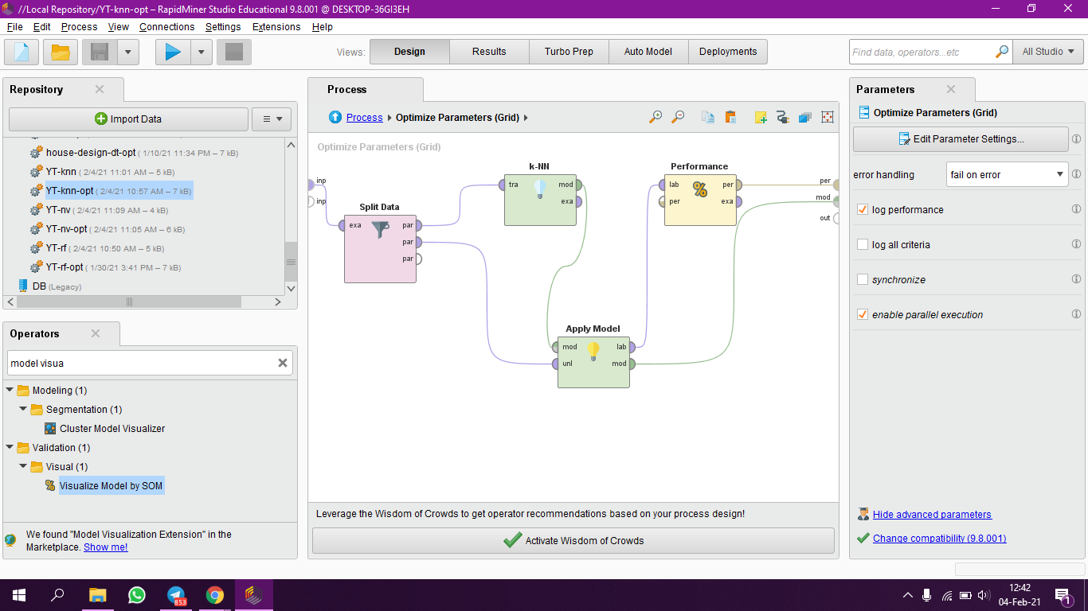
K-NN
Notes:
RapidMiner

Slide 32
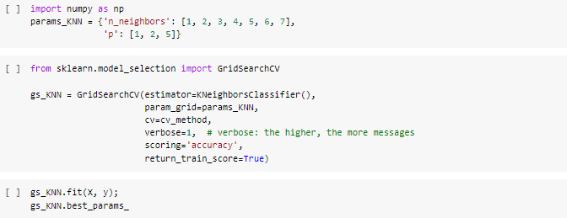
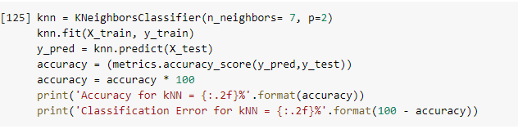
K-NN
Notes:
Python

Slide 33
RESULTS

Slide 34
Tools | Training Ratio | Test Ratio | Accuracy %
 |  |  | Before Hyperparameter Tuning |  |  | After Hyperparameter Tuning
 |  |  | Random Forest | Naive Bayes | k-NN | Random Forest | Naive Bayes | k-NN
RapidMiner | 70 | 30 | 99.95 | 93.06 | 99.80 | 100 | 92.38 | 100
 | 50 | 50 | 99.94 | 91.97 | 99.74 | 100 | 92.20 | 100
 | 30 | 70 | 99.90 | 91.42 | 99.69 | 100 | 91.14 | 99.94
Python | 70 | 30 | 99.85 | 90.57 | 99.80 | 99.85 | 93.55 | 99.85
 | 50 | 50 | 99.91 | 91.79 | 99.50 | 99.91 | 94.20 | 99.91
 | 30 | 70 | 99.90 | 91.29 | 99.37 | 99.90 | 94.41 | 99.92

Slide 35
ANALYSIS

Slide 36
Best model accuracy score before tuning:
Random Forest (RapidMiner and Python)
Best model accuracy score after tuning:
Random Forest (RapidMiner)
K-NN (Python)
Best overall model:
Random Forest with 70% training ratio and 30% training ratio
Notes:
Tgk result mana yang balik

Slide 37
INSIGHT

Slide 38
We provide the metric for the company to measure the performance of their marketing strategy through YouTube videos.
Cluster | Metric | Quantity
Best | Views | ≥626,794
 | Likes | ≥346
 | Comment | ≥3
 | Dislikes | ≥67
Notes:
Related dgn stakeholder

Slide 39
Cluster | Metric | Quantity
Moderate | Views | ≥322079
 | Likes | ≥363
 | Comment | ≥6
 | Dislikes | ≥38
Cluster | Metric | Quantity
Worst | Views | ≥100053
 | Likes | ≥91
 | Comment | ≥8
 | Dislikes | ≥3

Slide 40
DEPLOYMENT

Slide 41

Streamlit
Web app through streamlit
Predict the trending videos on youtube based on :
Views
Likes
Comments
Dislikes
With three classifiers :
Random forest
Naive bayes
kNN

Slide 42
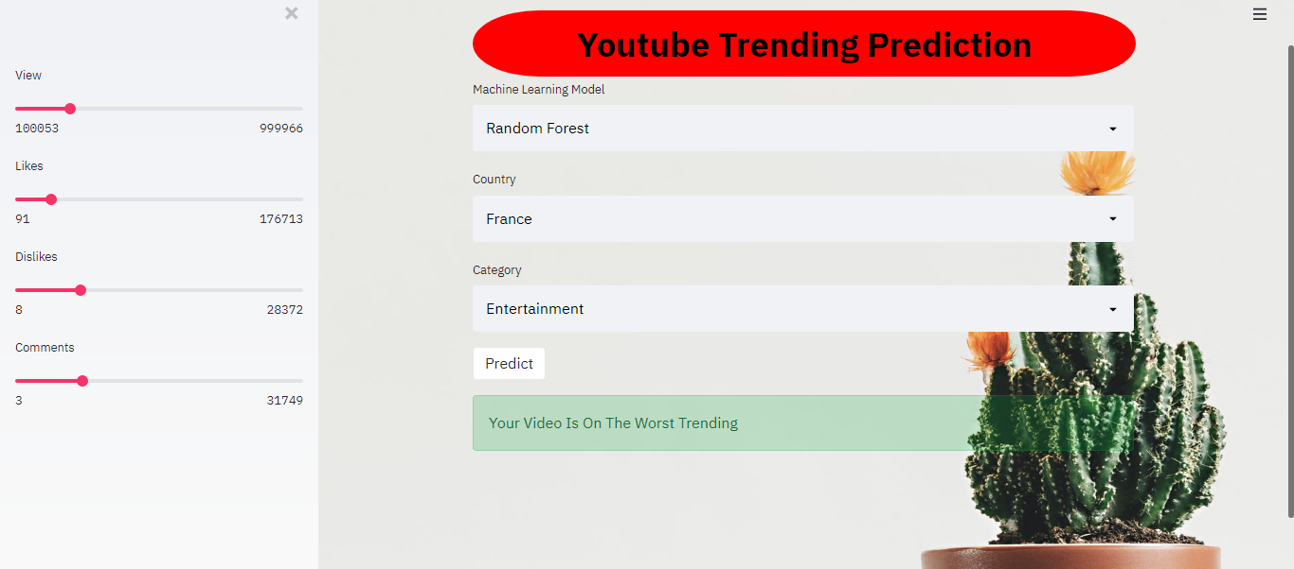

Slide 43
REFLECTION

Slide 44

Meor Amirul - Personally learning in this course & doing assignments have make me wondering what i have gained through the semester. I am not really good with many data so i tends to be slow in this project. Though that being said, I cannot deny the thrills and challenges from this project, also previous assignments. Thankfully, helps and guidances from team members, supportive friends and also Dr Fadhlina, makes me going throughout the whole semester and project. I wish all the best for all of us, thank you! :)
Ikhwan - This is really good experience for me even though I think it is quite hard and challenging. I learn many new things in this course that is important to be a data scientist from using tools like rapidminer, power bi and finally the deployment of the model. I am quite impressed what I have done throughout in this semester for this course. Finally, thank you to my group members and thank you to Dr. Fadhlina that always helps and guide us to be the best.
Syahmi - I love Data mining, I want to take my FYP in this field.
Data Mining

Slide 45

THANKS !
Notes:
Jimmiran

